Slide 1

Title slide + image
Collaborative reflection on personal data:
An approach to study context-related user experiences of recommender systems
Zihan Wang

Slide 2
Overview
Create/edit a Hyperlink TO A SLIDE
1
Go to the tab ‘Insert’ and click on the button ‘Shapes’. Choose the shape ‘Rectangle’ and drag the mouse over the slide to create a shape.
Shapes
2
Drag the shape over the menu button and scale the shape as large as the button. Click with the right mouse button on the shape and choose ‘Edit shape’.
Size and position…
Edit shape…
3
Click on the paint bucket icon, click on ‘Shape Fill’ and drag the ‘Transparency’ slider to 100%. Now the shape is completely transparent.
Introduction
Methodology
Results
Summary
Literature Review
Backgrounds
Research questions
Participants
Design principles
Task Design
Contextual factors
Human values
Design principles
Conclusion
Discussion
Transparency
100%
4
Click on the transparent shape and use the shortcut Ctrl + K to add a hyperlink. At the left side of the window, click on ‘Place in this document’ and select the preferred slide in the list. Then click on ‘OK’.
5
Copy the transparent shape and repeat step 4. Do this for all menu buttons.
Want to know more? Go to the tab 'SLIDEBUILDER’ and click on the button ‘Inspiration'
Inspiration
Notes:
In this presentation, I’ll introduce the motivations of this research and my research questions, followed by my review on the related literature. The third section will be the methodology, and i

Slide 3

Imagine you have just finished an exhausting period...
Notes:
According to Umair Javed et al’s research, context-aware recommendation systems can improve the accuracy and quality of recommendations. Therefore, a way to understand what influences users’ attitudes on recommendations is necessary. However, existing methods used by recommender systems are limited to capture contents-related issues and are not efficient enough to understand insights of users’ choices. For example, YouTube right now only provides options:Like or dislike, Tiktok provides relatively more detailed options but they are still limited to contents.
After our review on existing research, we found that most studies are on objective system aspects , which includes algorithms, interactions, etc. However, not too much research has been done to understand users. However, understand how users’ characteristics and situation is also an important part to give accurate recommendations that align with human values.

Slide 4

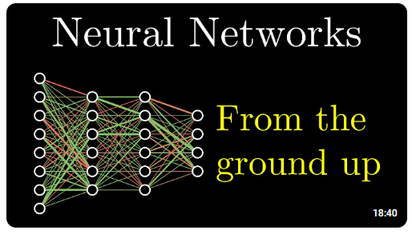
Which one will you choose?
Notes:
According to Umair Javed et al’s research, context-aware recommendation systems can improve the accuracy and quality of recommendations. Therefore, a way to understand what influences users’ attitudes on recommendations is necessary. However, existing methods used by recommender systems are limited to capture contents-related issues and are not efficient enough to understand insights of users’ choices. For example, YouTube right now only provides options:Like or dislike, Tiktok provides relatively more detailed options but they are still limited to contents.
After our review on existing research, we found that most studies are on objective system aspects , which includes algorithms, interactions, etc. However, not too much research has been done to understand users. However, understand how users’ characteristics and situation is also an important part to give accurate recommendations that align with human values.

Slide 5

What about now😉?
Notes:
According to Umair Javed et al’s research, context-aware recommendation systems can improve the accuracy and quality of recommendations. Therefore, a way to understand what influences users’ attitudes on recommendations is necessary. However, existing methods used by recommender systems are limited to capture contents-related issues and are not efficient enough to understand insights of users’ choices. For example, YouTube right now only provides options:Like or dislike, Tiktok provides relatively more detailed options but they are still limited to contents.
After our review on existing research, we found that most studies are on objective system aspects , which includes algorithms, interactions, etc. However, not too much research has been done to understand users. However, understand how users’ characteristics and situation is also an important part to give accurate recommendations that align with human values.

Slide 6
Contexts are making the differences

Slide 7
Chapter | dark mode
1
Introduction

Slide 8
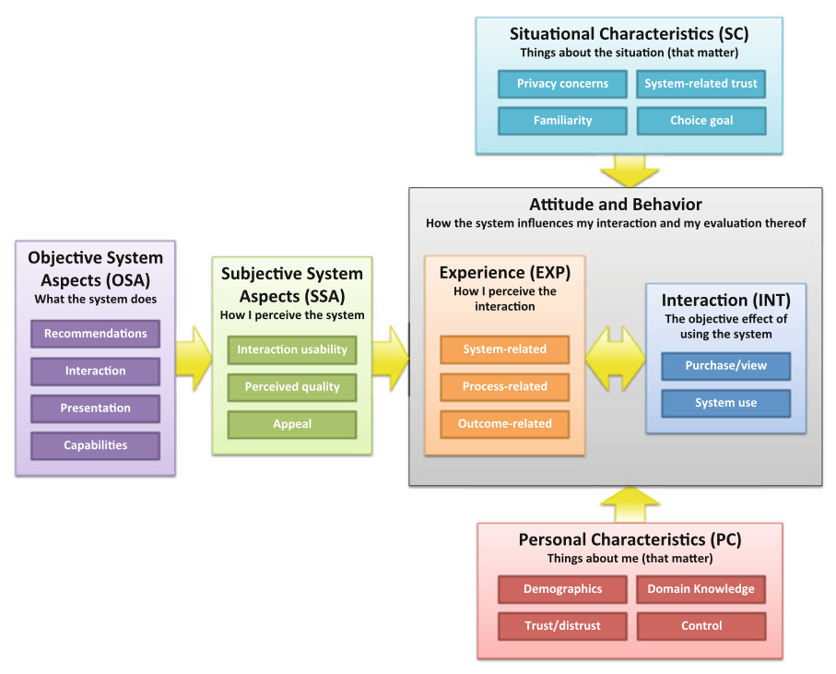
Motivations
Why?
User experience is contextual
Understanding the influences of context contribute to further improvements
A lot of research focuses on the system aspect, such as enhancing recommendation accuracy, but there is relatively little emphasis on the user side.
Framework for the user-centric evaluation of recommender systems[1]
1.
[1]Knijnenburg BP, Willemsen MC, Gantner Z, Soncu H, Newell C. Explaining the user experience of recommender systems. User Model User-Adap Inter. 2012;22(4):441-504. doi:10.1007/s11257-011-9118-4
Notes:
According to Umair Javed et al’s research, context-aware recommendation systems can improve the accuracy and quality of recommendations. Therefore, a way to understand what influences users’ attitudes on recommendations is necessary. However, existing methods used by recommender systems are limited to capture contents-related issues and are not efficient enough to understand insights of users’ choices. For example, YouTube right now only provides options:Like or dislike, Tiktok provides relatively more detailed options but they are still limited to contents.
After our review on existing research, we found that most studies are on objective system aspects , which includes algorithms, interactions, etc. However, not too much research has been done to understand users. However, understand how users’ characteristics and situation is also an important part to give accurate recommendations that align with human values.

Slide 9


Motivations
Why?
User experience is contextual
Understanding the influences of context contribute to further improvements
Much research focus on the system aspect such as improving recommendation accuracy, but not much on user sides.
Popular recommender systems haven't deployed an effective method to capture user context while evaluating user experiences.
Notes:
According to Umair Javed et al’s research, context-aware recommendation systems can improve the accuracy and quality of recommendations. Therefore, a way to understand what influences users’ attitudes on recommendations is necessary. However, existing methods used by recommender systems are limited to capture contents-related issues and are not efficient enough to understand insights of users’ choices. For example, YouTube right now only provides options:Like or dislike, Tiktok provides relatively more detailed options but they are still limited to contents.
After our review on existing research, we found that most studies are on objective system aspects , which includes algorithms, interactions, etc. However, not too much research has been done to understand users. However, understand how users’ characteristics and situation is also an important part to give accurate recommendations that align with human values.

Slide 10
Our target
To propose an approach that can efficiently investigate how context influence user experiences in recommender systems
Notes:
Due to the backgrounds we introduced before, we want to propose a method that can efficiently investigate what users want from recommender systems

Slide 11
What to find
What?
The way context affects the user experience
How context influences the values that users expect to be satisfied.
Context category | Context examples
Temporal Context | Time, Past experiences,…
Physical Context | Location, weather, …
Cognitive Context | Culture, religion,…
Task Context | Activities, routines,…
….
Notes:
Why we collect user feedback
To evaluate user experiences recommendatio, not improvements.
Explicit and qualitative feedback.
Feedback??主动问不一定算feedback
最后点名gap

Slide 12
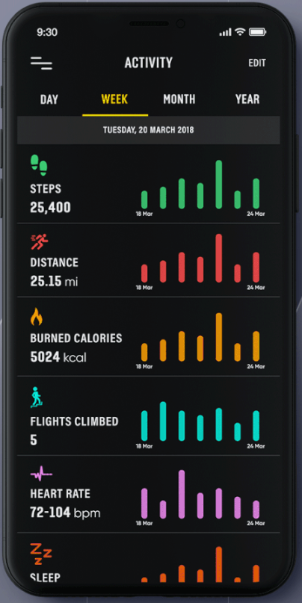
Reflection on personal data
How?
A process which people view and interact with their data to gain insights.
Exact numbers, extreme values, trends...
These data prompt people recall on the scenario when a data was recorded
Notes:
Due to the backgrounds we introduced before, we want to propose a method that can efficiently investigate what users want from recommender systems

Slide 13
Collaborative reflection
How?
People come together to discuss and share experiences, leading to insights that go beyond individual outcomes.
It highly relies on support for communication and experiences exchange
[1] Prilla, Michael. "Supporting collaborative reflection at work: A socio-technical analysis." AIS Transactions on Human-Computer Interaction 7.1 (2015): 1-17.

Slide 14
Knowledge gaps
The way context affects user experience is hardly explored
The effectiveness of applying collaborative reflection in user studies remain uncertain
[1] Prilla, Michael. "Supporting collaborative reflection at work: A socio-technical analysis." AIS Transactions on Human-Computer Interaction 7.1 (2015): 1-17.

Slide 15
Research Questions
How should we take context into consideration while evaluating recommender systems?
How does online collaborative reflection on personal data help find insights into user experiences on recommender systems?
Notes:
User experiences ,not behaviours

Slide 16
Chapter | dark mode
2
Methodology

Slide 17
Implementations
I built a platform where participants reflect on YouTube watching history as a case study
There are three tasks on the platform.
We get all our results from participants’ discussions
Notes:
图

Slide 18
Design Principles
Providing the foundation for reflection by co-construction to facilitate recall of past experiences/contexts
Encouraging communication upon cooperating for an answer to link and merge experiences.
Prompting contextual judgements of experiences to elicit personal value.
4
Notes:
The overall idea for all the principles is to facilitate collaborative sensemaking between two participants.
I proposed the following four design principles in the blue rectangles and they can be divided into two groups: One group is to help participants recall context while the other is for eliciting values.
The first one, Co-construct visualizations. Participants were asked to construct their visualizations by themselves in our method, and two participants work on a same board and we expect them to get some findings and discuss during the process.
The second one is that we wish participants to generate reflections on their behaviors by comparing with both themselves and their teammate. Examples are that participants may find similarities with their teammate and summarize out things they didn’t think of before.
As it is not easy for people to think about values. The third one, scenario recall is regarded as a preparation step before we ask participants about values. We provide participants with what happened during a day and we expect them to talk about how the videos watched fulfilled their values
The last one is called Contextual Judgements, participants are asked to judge the videos they watched based on the context when they watched the videos. We wish the step of asking them to judge can think about the deep reasons about how they like the video.

Slide 19
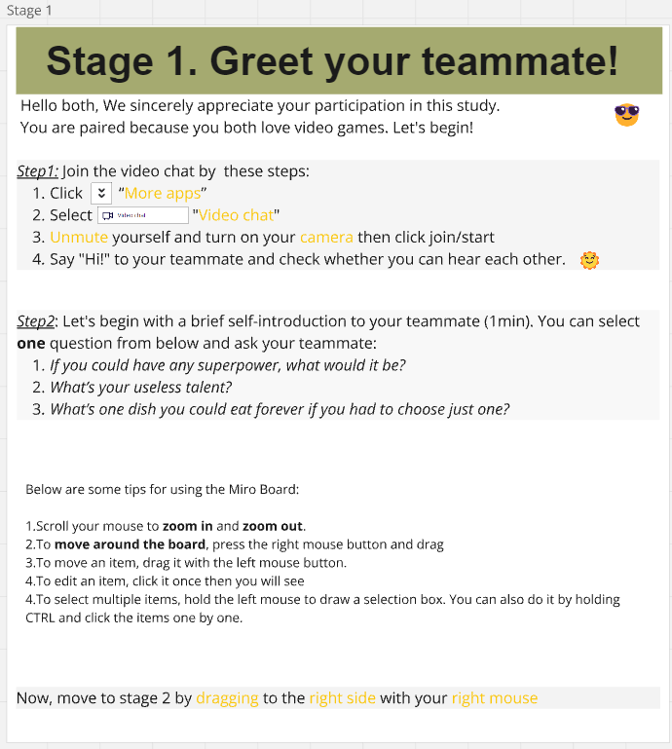
Task 1
An ice-breaking stage to get two participants familiar

Slide 20
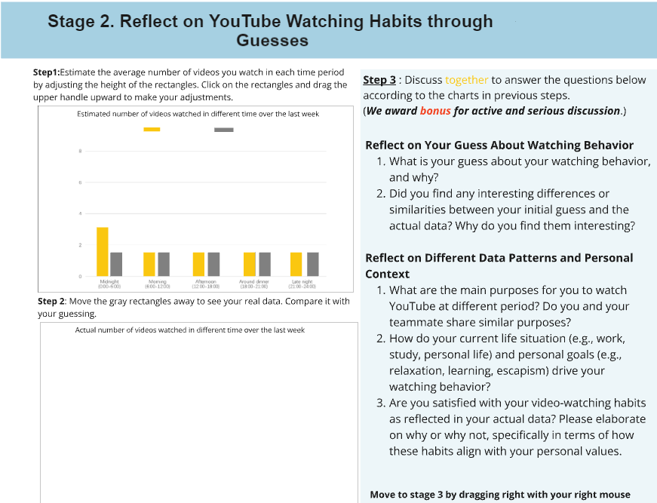
Task 2
Participants estimate their watching data
Compare with their real data
Discuss on the questions
1
2
3
4
5

Slide 21
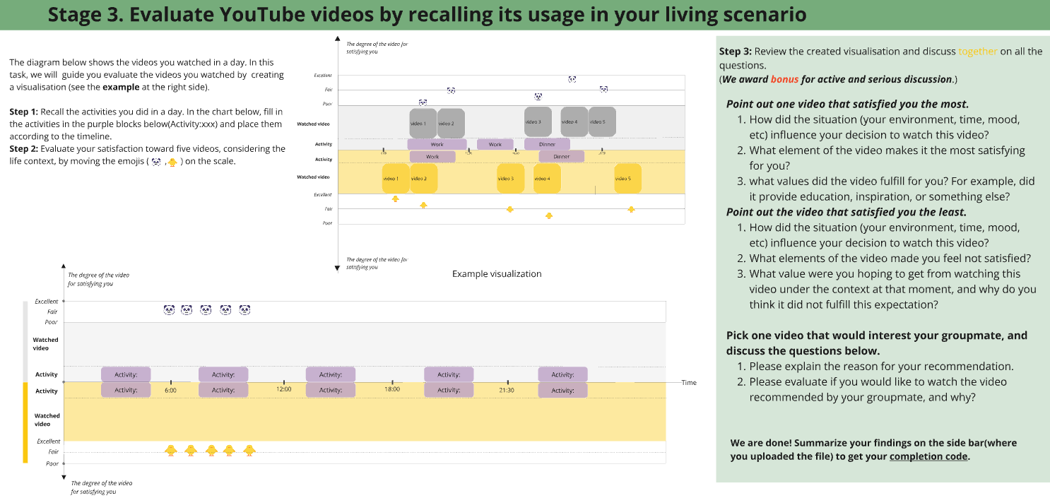
Task 3
Participants create a visualization of activities and videos watched on a specific date
Judge 5 videos based on how well they were satisfied
Select one most satisfying and one most disappointing video, and analyze the reasons
Recommend a video that would interest their groupmate and answer whether they like the video recommended to them
1
2
3
4
5
6
7
Notes:
Make tasks shorter

Slide 22
Analysis
We deductively coded the transcriptions of the discussions of each groups
Context codes
Value codes
Design principles codes
We watched the recordings of the operations on the board as another way to verify the accessibility of our method
[1] Nicholas A. Bradley and Mark D. Dunlop. 2005. Toward a Multidisciplinary Model of Context to Support Context-Aware Computing. Hum-Computer Interaction 20, 4, 403-446.
http://dx.doi.org/10.1207/s15327051hci2004_2
[2] J. Stray et al., “Building Human Values into Recommender Systems: An Interdisciplinary Synthesis,” ACM Trans. Recomm. Syst., vol. 2, no. 3, p. 20:1-20:57, Jun. 2024, doi: 10.1145/3632297.

Slide 23
Participants
We hired our participants from both crowdsourcing platform and off-line.
Group A(26 participants): Crowd workers aged from 20-35, European countries citizens, any gender, actively using YouTube, playing video games, and willing to take part in a video interview
Group B (8 participants): Voluntary participants found off-line. Students

Slide 24
Chapter | dark mode
3
Results

Slide 25
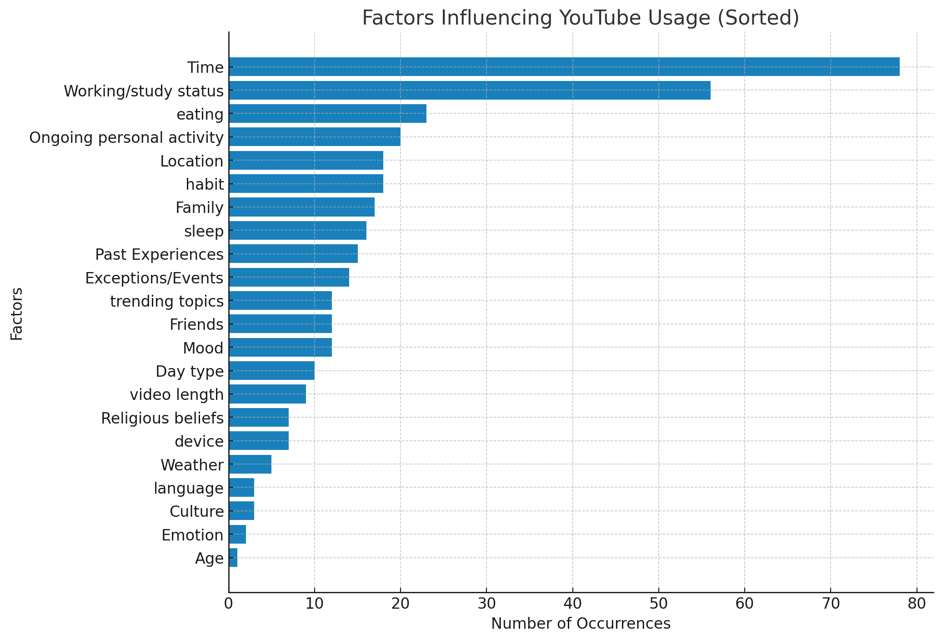
Contexts
Top 3 mentioned contexts: Time, work/study status, and eating

Slide 26

Case 1. The ongoing activity influences the selection of videos
Demographic: 25 years old, working for a consulting company, living on her own
She usually watches informative videos while cooking
However, she mentioned that she wouldn’t choose the video if she was eating
Values: From looking for companionship to entertainment.

Slide 27
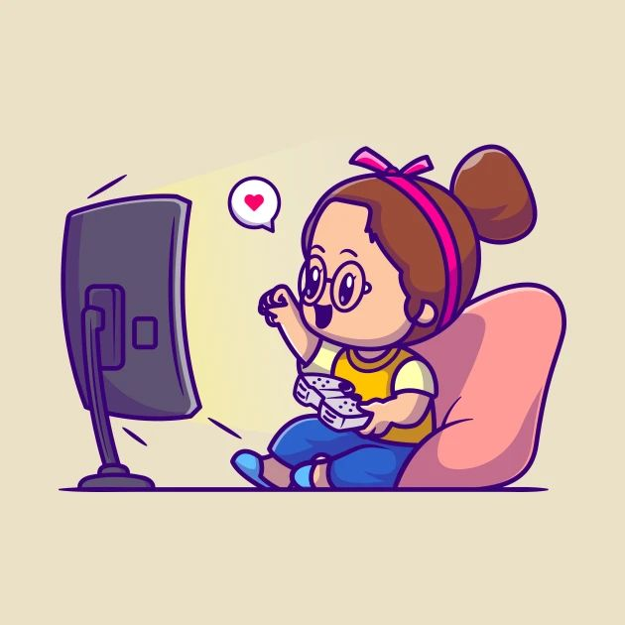
Case 2. Personal context contributes to the video selection
Demographic: 25 years old, working, loves computer games but can’t play them well.
She usually watched others playing the games she likes and she regards it as a way to enjoy the game without committing to playing the game herself
A kind of vicarious fulfillment
Values: Accomplishment and enjoyment

Slide 28
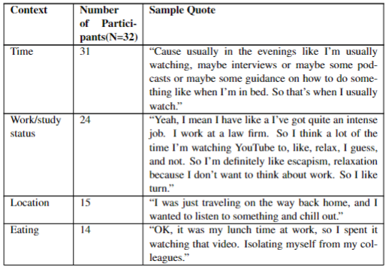
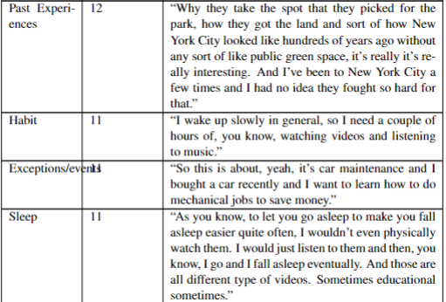
Contexts
For each context, I selected the most representing quote

Slide 29
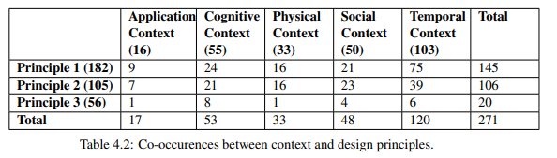
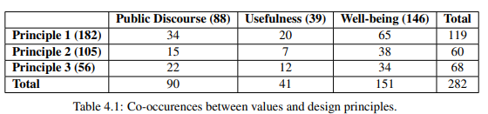
Design Principles
1.Providing the foundation for reflection by co-construction to facilitate recall of past experiences/contexts
2.Encouraging communication upon cooperating for an answer to link and merge experiences.
3.Prompting contextual judgements of experiences to elicit personal value.
P1 performs well in eliciting values and context
P2 effectively facilitated reflection on context but not on values.
P3 performed to our expectation on eliciting values, but its performance in finding related context is not good
Notes:
We can give a preliminary deduction that providing materials that people can refer to is the basis for them to reflect on context and values, and helps their thinking about insights of their experiences. Principle 2 and 3 have their speciality. Experiences merging(Principle 2) can help people do more thinking in the context of their experiences but is not very effective in finding values. As for letting participants make contextual judgements, we can make a prima facie case that it is useful on eliciting discussion about values. Since it’s designed mainly for finding values, its poor performance of findings context is acceptable.

Slide 30

Merging experiences supports cooperative reflection
Drew recommended an MV of a song called ”The Coconut Song” to her teammate Lily, because this video can bring happiness
Lily immediately responded that she also loves this song and she always plays this song whenever she drives a long distance.
This makes them reflect on the context and the values they got by listening to this song naturally without checking our questions.

Slide 31

Contextual judgments inspire thinking of the scenario and values
Judy, an assistant at a law firm, and she usually feels exhausted after work
She expressed her displeasure with a video she played for her younger brother.
We understood the scenarios when she watched the video and the values she wished to receive by prompting her make the contextual judgements.

Slide 32
Method Usability
Total Number of Participants (N): 26
Participants left in the Waiting Room: 6 (23%)
Paired successfully but didn’t Join the Miro Board: 5(19%)
Participants left after entering the Miro board: 7 (27%)

Slide 33
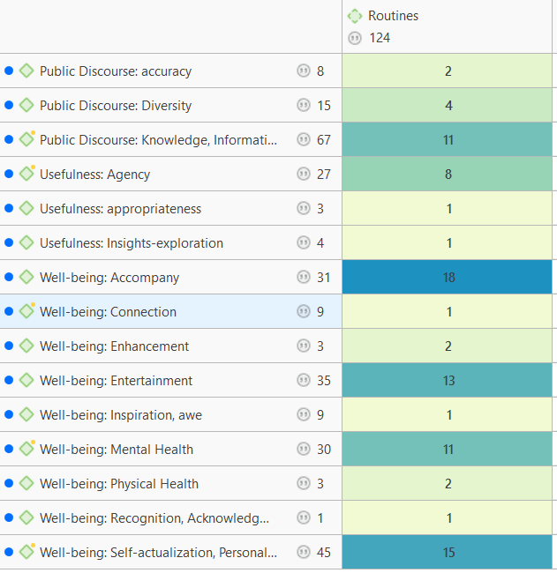
Findings
People watch videos to find accompany in their daily routines(Eating, cook, sleep, etc)
People watch videos to relief stress during/after work.

Slide 34
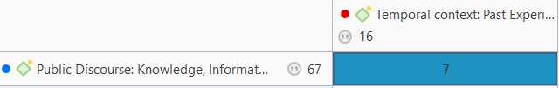
Findings
People watch videos to find accompany in their daily routines(Eating, cook, sleep, etc)
People watch videos to relief stress during/after work.
People are easily attracted by things they once experienced and become interested in learning more.
Notes:
对evaluation 的帮助

Slide 35
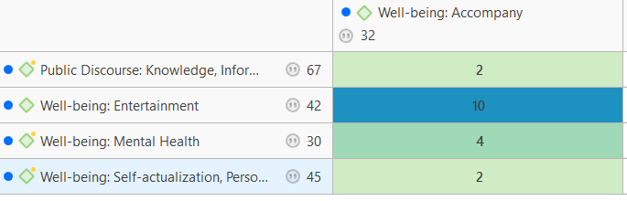
Findings
People watch videos to find accompany in their daily routines(Eating, cook, sleep, etc)
People watch videos to relief stress during/after work.
People are easily attracted by things they once experienced and become interested in learning more.
When people watch videos for companionship, they tend to watch lighthearted videos rather than serious ones.

Slide 36
Chapter | dark mode
4
Conclusions

Slide 37
To answer Q1
We found that daily routines had the greatest influence
Daily routines highly correlate with other contexts such as time and location
We do not evaluate a recommender system only on whether the systems give content that users are interested in. We should examine whether the contents are the most appropriate ones in the scenario.
How should we take context into consideration while evaluating recommender systems?
Notes:
It should align with users’ daily routines and give the most appropriate recommendations at each period instead of giving similar ones across the day.

Slide 38
To answer Q1
The less occurred context(mood, events…) are unpredictable
The causes of these context could be a stable context
When evaluating user experiences on recommender systems, we should examine whether the systems can capture unusual context.
How should we take context into consideration while evaluating recommender systems?
Notes:
It should align with users’ daily routines and give the most appropriate recommendations at each period instead of giving similar ones across the day.

Slide 39
To answer Q2
DP1.Providing the foundation for reflection by co-construction to facilitate recall of past experiences/contexts
DP2.Encouraging communication upon cooperating for an answer to link and merge experiences.
DP3.Prompting contextual judgements of experiences to elicit personal value.
When giving enough support, participants can reflect on their past experiences smoothly and think of v
DP1 ensures that participants are thoroughly familiar with their own data, providing the foundation for principles 2 and 3.
Collaborative settings contribute to reflections on the whole process
It brought out reflection in natural discussions
RQ2:How does online collaborative reflection on personal data help find insights into user experiences on recommender systems?
Notes:
It should align with users’ daily routines and give the most appropriate recommendations at each period instead of giving similar ones across the day.

Slide 40
Contributions
It fills the knowledge gap of there is no effective method for evaluating how a recommender system deals with user context with a user study approach using collaborative reflection.
The study found how context influences users’ experiences on recommender systems and the values they wish to be fulfilled under different contexts.

Slide 41
Limitations
Relatively strict requirements for participants
Participant groups lack diversity

Slide 42
Future works
Research on how to include these contexts comprehensively in the algorithms
A detailed evaluation framework of recommender systems considering the context
Test the approach with more diverse participant groups

Slide 43
Thanks for your patience
Zihan Wang

